Slide 1
Coursework: Whac-a-mole
You have been provided with code for a very simple game. You will need to extend and improve this, using the following requirements:
HIT OR MISS: Check whether the button press happens at the same time as an LED. How you implement this is up to you (for example, you could use interrupts, a tight loop, or system time).
SCORING: Add a score that is incremented if the player presses the button while an LED is on (consider how you will display this).
WIN: When the score reaches 10, flash all LEDs on to indicate the game is over.
2 PLAYER: Add three red LEDs and a second button to the circuit. Adapt your game so that button 1 needs to be pressed for a lit green LED, and button 2 for a lit red LED.
SERVO: Use of a servo in a creative way (for example to show the score)!
These elements are CORE functionality and MUST ALL be completed.

Slide 2
Coursework: Whac-a-mole
If you complete the essential functionality, consider adding the following:
TRIPLE PLAYER: Add a third button and colour to the game.
DIFFICULTY: Vary the duration LEDs are lit and the time between them.
SOUND: Include sound output (for correct/incorrect button presses)
You are welcome to be creative and implement your own additional functionality. Experiment with different sensors, or different variables in your code – you might discover a few things that you decide to use again when working on coursework 2.

Slide 3
Coursework: Whac-a-mole
The below is the previous year marking scheme. Whilst this submission is formative, use the below as a guide for what we are looking for.
Remember, coursework 2 is very similar to this – use this as an opportunity to practice your report writing, video editing and coding.
1) Solution + Presentation | 50 marks | Solution works according to requirements; calibrated according to challenge of the problem. Demo is well executed. Shows clear understanding of the solution
1.1) Core implementation | 29 marks
1.2) 3 Additional Functionalities | 21 marks
2) Code | 25 marks | Clear code. Appropriate comments, names of functions and variables. Easy to understand.
2.1) Core implementation | 10 marks
2.2) 3 Additional Functionalities | 15 marks
3) Mini-report | 25 marks | Clarity and conciseness of communication; appropriate presentation (written, graphic, etc). Photo of the solution. Inlcudes reference sources if necessary.

Slide 4
Whac-a-mole game
This game uses 3 green LEDs, one white LED and a button.
The green LEDs will turn on at random for a short period of time.
The player’s goal is to press the button when one of them lights up.
If the player presses the button in time, the white LED flashes to indicate that a point has been scored.
Note: You can use any colour LEDs

Slide 5
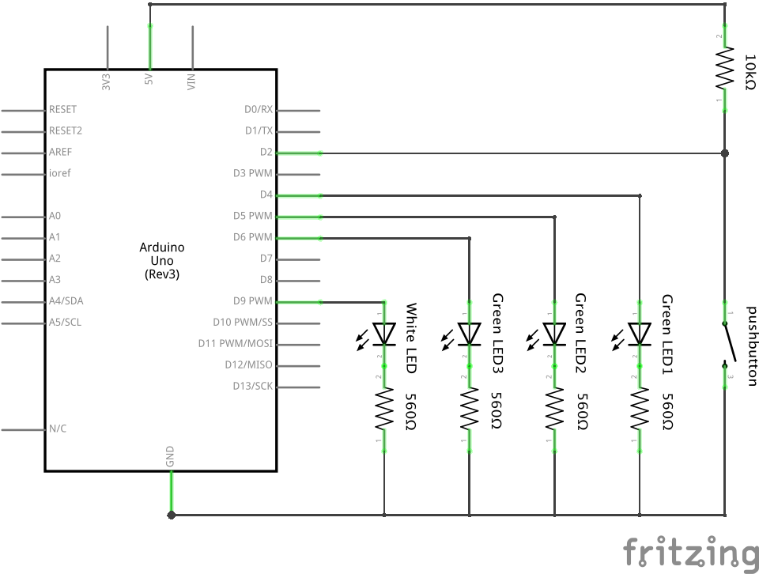
Basic Schematic: Whac-a-mole game

Slide 6
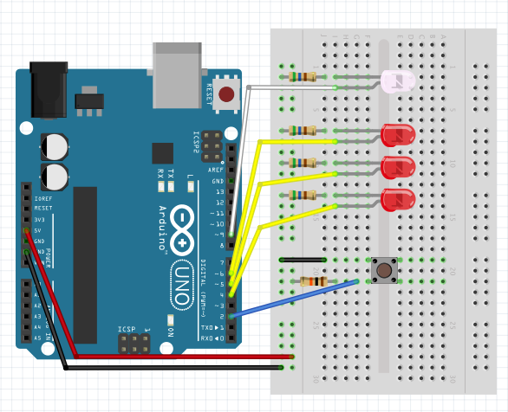
Basic Breadboard Layout: Whac-a-mole game

